Slide 1
TISS Presentation
Presentation On Data Structure

Slide 2
Data Structure Presentation
Data Structures are the programmatic way of storing data so that data can be used efficiently. Almost every enterprise application uses various types of data structures in one or the other way.

Slide 3
Data Structure Presentation
Data Structure is a systematic way to organize data in order to use it efficiently. Following terms are the foundation terms of a data structure.
Interface − Each data structure has an interface. Interface represents the set of operations that a data structure supports. An interface only provides the list of supported operations, type of parameters they can accept and return type of these operations.
Implementation − Implementation provides the internal representation of a data structure. Implementation also provides the definition of the algorithms used in the operations of the data structure.

Slide 4
Data Structure Presentation
Characteristics of Data Structure:- The Characterstics of Data Structure are as follows:
Correctness
Time Complexity
Space Complexity

Slide 5
Data Structure Presentation
Need of Data Structure:- As applications are getting complex and data rich, there are three common problems that applications face now-a-days.:
Processor Speed
Data Search
Multiple Request

Slide 6
Data Structure Presentation
Execution Time Cases:- As applications are getting complex and data rich, there are three common problems that applications face now-a-days.:
Worst Case
Best Case
Average Case

Slide 7
Data Structure Presentation
Basic Terminology:-
Data − Data are values or set of values.
Data Item − Data item refers to single unit of values.
Group Items − Data items that are divided into sub items are called as Group Items.
Elementary Items − Data items that cannot be divided are called as Elementary Items.
Attribute and Entity − An entity is that which contains certain attributes or properties, which may be assigned values.
Entity Set − Entities of similar attributes form an entity set.
Field − Field is a single elementary unit of information representing an attribute of an entity.
Record − Record is a collection of field values of a given entity.
File − File is a collection of records of the entities in a given entity set.

Slide 8
Data Structure Presentation
Basic Terminology:-
Local Environment Setup:-
Text Editor
C Compiler

Slide 9
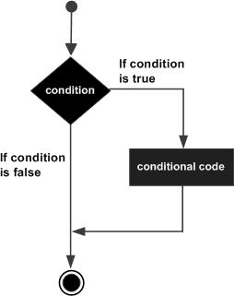
Data Structure Presentation
Decision Making Statement:-
If Statement:-

Slide 10
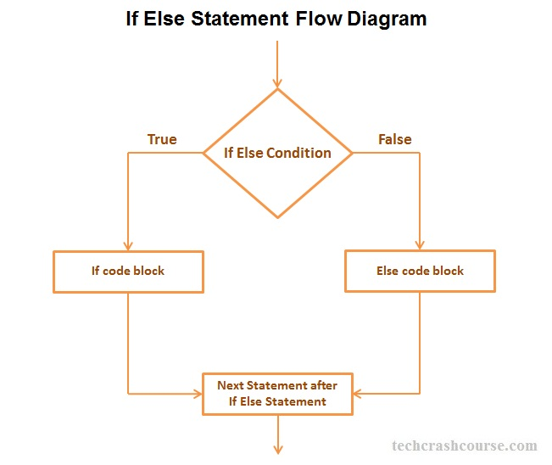
Data Structure Presentation
Decision Making Statement:-
If-else Statement:-

Slide 11
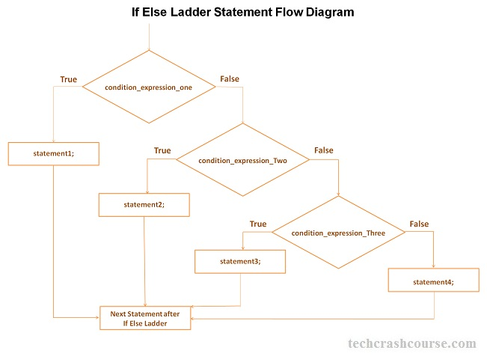
Data Structure Presentation
Decision Making Statement:-
If-else-if Statement:-

Slide 12
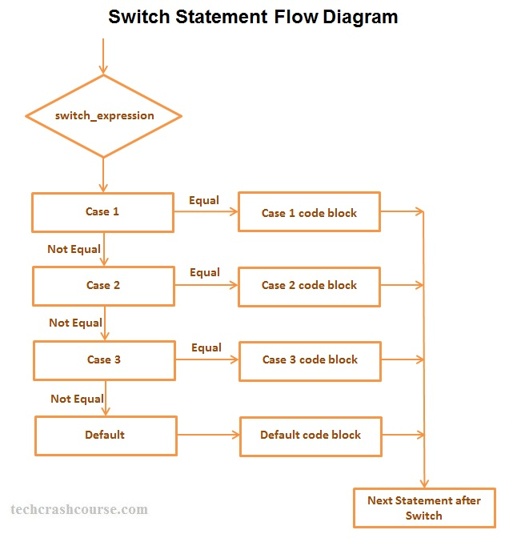
Data Structure Presentation
Decision Making Statement:-
Switch Statement:-

Slide 13
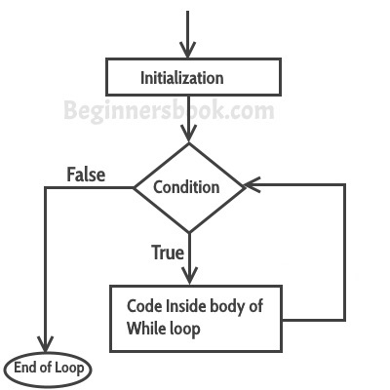
Data Structure Presentation
Looping Statement:-
while Statement:-

Slide 14
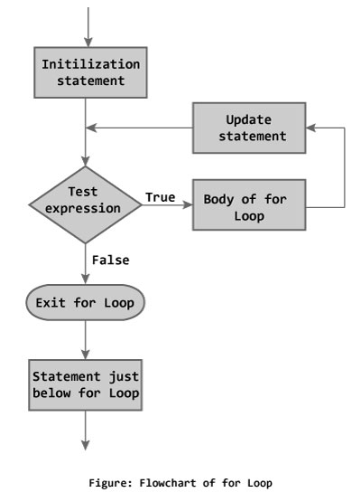
Data Structure Presentation
Looping Statement:-
for Statement:-

Slide 15
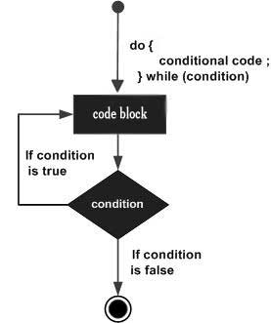
Data Structure Presentation
Looping Statement:-
Do-while Statement:-

Slide 16
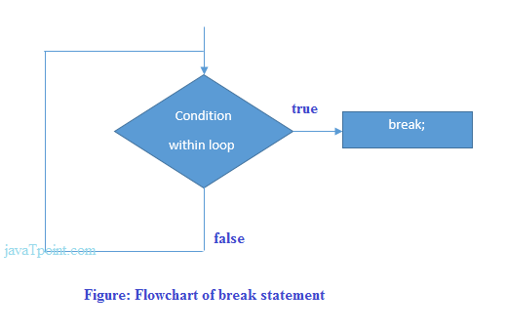
Data Structure Presentation
Jumping Statement:-
Break Statement:-

Slide 17
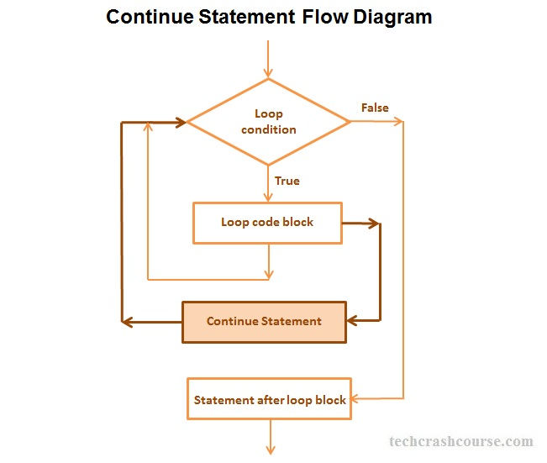
Data Structure Presentation
Jumping Statement:-
Continue Statement:-

Slide 18
Data Structure Presentation
Jumping Statement:-
goto Statement:- The goto statement is known as jump statement in C language. It is used to unconditionally jump to other label. It transfers control to other parts of the program.
Syntax:- goto label;

Slide 19
Data Structure Presentation
Jumping Statement:-
continue Statement:-
The continue statement in C language is used to continue the execution of loop (while, do while and for). It is used with if condition within the loop.
In case of inner loops, it continues the control of inner loop only.

Slide 20
Data Structure Presentation
Jumping Statement:-
continue Statement:-#include<stdio.h>
int main(){
int i=1;//initializing a local variable
//starting a loop from 1 to 10
for(i=1;i<=10;i++){
if(i==5){//if value of i is equal to 5, it will continue the loop
continue;
}
printf("%d \n",i);
}//end of for loop
return 0;
}
O/P:- 1 2 3 4 5 6 7 8 9 10

Slide 21
Data Structure Presentation
Function:- The function in C language is also known as procedure or subroutine in other programming languages.
To perform any task, we can create function. A function can be called many times. It provides modularity and code reusability.

Slide 22
Data Structure Presentation
Advantages of Function:-
Code Reusability
Code Optimization

Slide 23
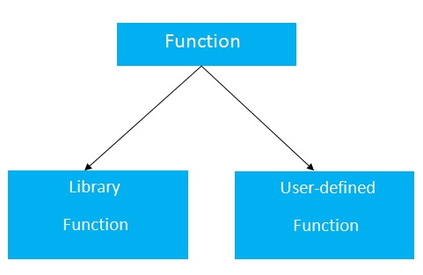
Data Structure Presentation
Types of Function:-There are two types of functions in C programming:
Library Functions: are the functions which are declared in the C header files such as scanf(), printf(), gets(), puts(), ceil(), floor() etc.
User-defined functions: are the functions which are created by the C programmer, so that he/she can use it many times. It reduces complexity of a big program and optimizes the code.

Slide 24
Data Structure Presentation
Return Value:-
int get(){
return 10;
}

Slide 25
Data Structure Presentation
Parameter in C Function:-
Example of a function that has 0 parameter:
void hello(){
printf("hello c");
}
Example of a function that has 1 parameter:
int cube(int n){
return n*n*n;
}
Example of a function that has 2 parameters:
int add(int a, int b){
return a+b;
}

Slide 26
Data Structure Presentation
Calling A C Function:-
If a function returns any value, you need to call function to get the value returned from the function. The syntax of calling a function in c programming is given below:
variable=function_name(arguments...);
1) variable: The variable is not mandatory. If function return type is void, you must not provide the variable because void functions doesn't return any value.
2) function_name: The function_name is name of the function to be called.
3) arguments: You need to provide arguments while calling the C function. It is also known as actual arguments.
Example to call a function:
hello();//calls function that doesn't return a value
int value=get();//calls function that returns value
int value2=add(10,20);//calls parameterized function by passing 2 values

Slide 27
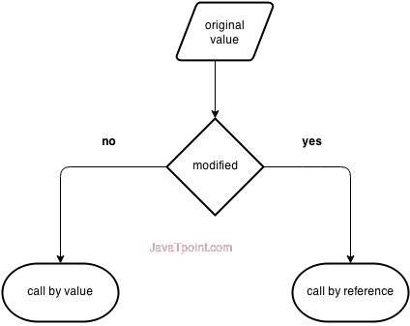
Data Structure Presentation
Call By Value and Call By Reference:-

Slide 28
Data Structure Presentation
Asymptotic Analysis:- Asymptotic analysis of an algorithm refers to defining the mathematical boundation/framing of its run-time performance. Using asymptotic analysis, we can very well conclude the best case, average case, and worst case scenario of an algorithm.
Usually, the time required by an algorithm falls under three types −
Best Case − Minimum time required for program execution.
Average Case − Average time required for program execution.
Worst Case − Maximum time required for program execution.

Slide 29
Data Structure Presentation
Data Structure and Algorithm basic Concept:-
Data Definition:- Data Definition defines a particular data with the following characteristics.
Atomic − Definition should define a single concept.
Traceable − Definition should be able to be mapped to some data element.
Accurate − Definition should be unambiguous.
Clear and Concise − Definition should be understandable.

Slide 30
Data Structure Presentation
Data Type:-
Data type is a way to classify various types of data such as integer, string, etc. which determines the values that can be used with the corresponding type of data, the type of operations that can be performed on the corresponding type of data. There are two data types −
Built-in Data Type
Derived Data Type

Slide 31
Data Structure Presentation
Built-In Data Type:-
Those data types for which a language has built-in support are known as Built-in Data types. For example, most of the languages provide the following built-in data types.
Integers
Boolean (true, false)
Floating (Decimal numbers)
Character and Strings

Slide 32
Data Structure Presentation
Derived Data Type:-
Those data types which are implementation independent as they can be implemented in one or the other way are known as derived data types. These data types are normally built by the combination of primary or built-in data types and associated operations on them. For example −
List
Array
Stack
Queue

Slide 33
Data Structure Presentation
Basic Operation :-
The data in the data structures are processed by certain operations. The particular data structure chosen largely depends on the frequency of the operation that needs to be performed on the data structure.
Traversing
Searching
Insertion
Deletion
Sorting
Merging

Slide 34
Data Structure Presentation
Sorting Operation in DS:-
Sorting refers to arranging data in a particular format. Sorting algorithm specifies the way to arrange data in a particular order. Most common orders are in numerical or lexicographical order.
Following are some of the examples of sorting in real-life scenarios −
Telephone Directory − The telephone directory stores the telephone numbers of people sorted by their names, so that the names can be searched easily.
Dictionary − The dictionary stores words in an alphabetical order so that searching of any word becomes easy.

Slide 35
Data Structure Presentation
Bubble Sorting Operation in DS:-
Bubble sort is a simple sorting algorithm. This sorting algorithm is comparison-based algorithm in which each pair of adjacent elements is compared and the elements are swapped if they are not in order. This algorithm is not suitable for large data sets as its average and worst case complexity are of Ο(n²) where n is the number of items.

Slide 36
Data Structure Presentation
Algorithm :-
begin BubbleSort(list)
for all elements of list
if list[i]>list[i+1]
swap(list[i],list[i+1])
end if
end for
return list
end Bubble Sort

Slide 37
Data Structure Presentation
Code :-
begin BubbleSort(list)
for all elements of list
if list[i]>list[i+1]
swap(list[i],list[i+1])
end if
end for
return list
end Bubble Sort

Slide 38
Data Structure Presentation
Code :-
void bubbleSortBasic(int *a,int n)
{
int j,k,temp;
for(k=1;k<n;k++)
{
for(j=0;j<n-k;j++){
if(a[j]>a[j+1])
{temp=a[j];
a[j]=a[j+1];
a[j+1]=temp;
}
}
}
}

Slide 39
Data Structure Presentation
Insertion Sort :- This is an in-place comparison-based sorting algorithm. Here, a sub-list is maintained which is always sorted. For example, the lower part of an array is maintained to be sorted. An element which is to be 'insert'ed in this sorted sub-list, has to find its appropriate place and then it has to be inserted there. Hence the name, insertion sort.

Slide 40
Data Structure Presentation
Algorithm of Insertion Sort :-
Step 1:- If it is the first time, it is already sorted.
Sterp2:- Pick the next element.
Step 3:- Compare with all the elements in the sorted sub-list.
Step 4:- Shift all the elements sorted sub-list.
Step 5:- Insert the value.
Step 6:- Repeat until the list is sorted.

Slide 41
Data Structure Presentation
Code of Insertion Sort :-
Step 1:- If it is the first time, it is already sorted.
Sterp2:- Pick the next element.
Step 3:- Compare with all the elements in the sorted sub-list.
Step 4:- Shift all the elements sorted sub-list.
Step 5:- Insert the value.
Step 6:- Repeat until the list is sorted.

Slide 42
Data Structure Presentation
Algorithm of Insertion Sort :-
Step 1:- If it is the first time, it is already sorted.
Sterp2:- Pick the next element.
Step 3:- Compare with all the elements in the sorted sub-list.
Step 4:- Shift all the elements sorted sub-list.
Step 5:- Insert the value.
Step 6:- Repeat until the list is sorted.

Slide 43
Data Structure Presentation
Code of Insertion Sort :-
void insertionSort(int arr[], int n)
{
int i, key, j;
for (i = 1; i < n; i++)
{
key = arr[i];
j = i-1;
while (j >= 0 && arr[j] > key)
{
arr[j+1] = arr[j];
j = j-1;
}
arr[j+1] = key;
}
}

Slide 44
Data Structure Presentation
Selection Sort :- Selection sort is a simple sorting algorithm. This sorting algorithm is an in-place comparison-based algorithm in which the list is divided into two parts, the sorted part at the left end and the unsorted part at the right end. Initially, the sorted part is empty and the unsorted part is the entire list.

Slide 45
Data Structure Presentation
Algorithm of Selection Sort :-
Step 1:- Set min to location 0.
Sterp2:- Search the minimum element in the list.
Step 3:- Swap the value at the location min.
Step 4:- Increment min to point the next element.
Step 5:- Repeat until the list is sorted.

Slide 46
Data Structure Presentation
Code of Selection Sort :-
void selectionSort(int arr[], int n)
{
int i, j, min_idx;
// One by one move boundary of unsorted subarray
for (i = 0; i < n-1; i++)
{
// Find the minimum element in unsorted array
min_idx = i;
for (j = i+1; j < n; j++)
if (arr[j] < arr[min_idx])
min_idx = j;
// Swap the found minimum element with the first element
swap(&arr[min_idx], &arr[i]);
}
}

Slide 47
Data Structure Presentation
Quick Sort :- Quick sort is a highly efficient sorting algorithm and is based on partitioning of array of data into smaller arrays. A large array is partitioned into two arrays one of which holds values smaller than the specified value, say pivot, based on which the partition is made and another array holds values greater than the pivot value.

Slide 48
Data Structure Presentation
Quick Sort :- Quick sort is a highly efficient sorting algorithm and is based on partitioning of array of data into smaller arrays. A large array is partitioned into two arrays one of which holds values smaller than the specified value, say pivot, based on which the partition is made and another array holds values greater than the pivot value.

Slide 49
Data Structure Presentation
Code for Quick Sort :- void quickSortIterative(int a[],int n)
{ int loc,beg,end;
stack *top;
createStack(&top);
push(&top,0);
push(&top,n-1);
while(!isEmpty(top))
{ end=pop(&top);
beg=pop(&top);
reduction(a,beg,end,&loc);
if(beg<loc-1){ push(&top,beg);
push(&top,loc-1)
} if(end>loc+1){
push(&top,loc+1);
push(&top,end);
}
}
}

Slide 50
Data Structure Presentation
Linked List Presentation:- Linked List can be defined as collection of objects called nodes that are randomly stored in the memory.
A node contains two fields i.e. data stored at that particular address and the pointer which contains the address of the next node in the memory.
The last node of the list contains pointer to the null.

Slide 51
Data Structure Presentation
Usage of Linked List:- The list is not required to be contiguously present in the memory. The node can reside any where in the memory and linked together to make a list. This achieves optimized utilization of space.
list size is limited to the memory size and doesn't need to be declared in advance.
Empty node can not be present in the linked list.
We can store values of primitive types or objects in the singly linked list.

Slide 52
Data Structure Presentation
Advantages of Linked List over Array:- Array contains following limitations:
The size of array must be known in advance before using it in the program.
Increasing size of the array is a time taking process. It is almost impossible to expand the size of the array at run time.
All the elements in the array need to be contiguously stored in the memory. Inserting any element in the array needs shifting of all its predecessors.

Slide 53
Data Structure Presentation
Singly Linked List:- Singly linked list can be defined as the collection of ordered set of elements. The number of elements may vary according to need of the program. A node in the singly linked list consist of two parts: data part and link part. Data part of the node stores actual information that is to be represented by the node while the link part of the node stores the address of its immediate successor.
One way chain or singly linked list can be traversed only in one direction. In other words, we can say that each node contains only next pointer, therefore we can not traverse the list in the reverse direction.

Slide 54
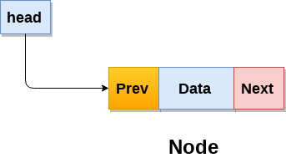
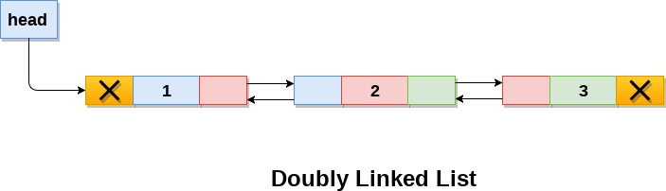
Data Structure Presentation
Doubly Linked List:- Doubly linked list is a complex type of linked list in which a node contains a pointer to the previous as well as the next node in the sequence. Therefore, in a doubly linked list, a node consists of three parts: node data, pointer to the next node in sequence (next pointer) , pointer to the previous node (previous pointer). A sample node in a doubly linked list is shown in the figure.

Slide 55
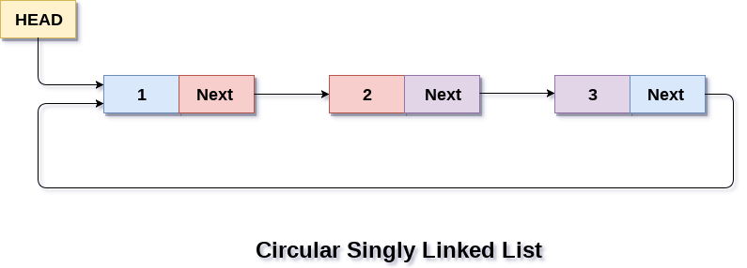
Data Structure Presentation
Circular Singly Linked List:- In a circular Singly linked list, the last node of the list contains a pointer to the first node of the list. We can have circular singly linked list as well as circular doubly linked list. We traverse a circular singly linked list until we reach the same node where we started. The circular singly liked list has no beginning and no ending. There is no null value present in the next part of any of the nodes.
The following image shows a circular singly linked list.

Slide 56
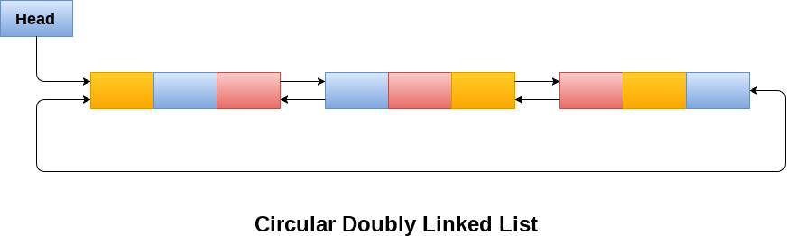
Data Structure Presentation
Circular Doubly Linked List:- Circular doubly linked list is a more complexed type of data structure in which a node contain pointers to its previous node as well as the next node. Circular doubly linked list doesn't contain NULL in any of the node. The last node of the list contains the address of the first node of the list. The first node of the list also contain address of the last node in its previous pointer.
A circular doubly linked list is shown in the following figure.

Slide 57
Data Structure Presentation
Stack:- Stack is an ordered list in which, insertion and deletion can be performed only at one end that is called top.
Stack is a recursive data structure having pointer to its top element.
Stacks are sometimes called as Last-In-First-Out (LIFO) lists i.e. the element which is inserted first in the stack, will be deleted last from the stack.

Slide 58
Data Structure Presentation
Application of Stack:-
Recursion
Expression evaluations and conversions
Parsing
Browsers
Editors
Tree Traversals

Slide 59
Data Structure Presentation
Array implementation of Stack:-
In array implementation, the stack is formed by using the array. All the operations regarding the stack are performed using arrays.

Slide 60
Data Structure Presentation
Array implementation of Stack:-
Adding an element onto the stack (push operation)
Adding an element into the top of the stack is referred to as push operation. Push operation involves following two steps.
Increment the variable Top so that it can now refere to the next memory location.
Add element at the position of incremented top. This is referred to as adding new element at the top of the stack.
Stack is overflown when we try to insert an element into a completely filled stack therefore, our main function must always avoid stack overflow condition.

Slide 61
Data Structure Presentation
Array implementation of Stack:-
Algorithm:
begin
if top = n then stack full
top = top + 1
stack (top) : = item;
end

Slide 62
Data Structure Presentation
Linked implementation of Stack:- Instead of using array, we can also use linked list to implement stack. Linked list allocates the memory dynamically. However, time complexity in both the scenario is same for all the operations i.e. push, pop and peek.
In linked list implementation of stack, the nodes are maintained non-contiguously in the memory. Each node contains a pointer to its immediate successor node in the stack. Stack is said to be overflown if the space left in the memory heap is not enough to create a node.

Slide 63
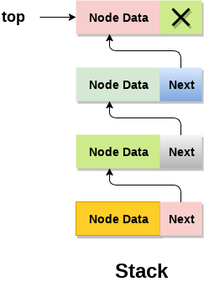
Data Structure Presentation
Linked implementation of Stack:-

Slide 64
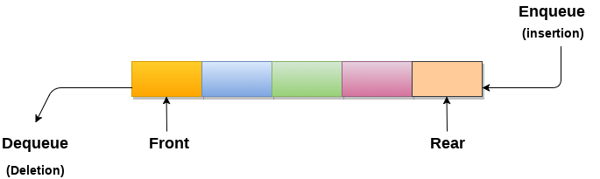
Data Structure Presentation
Queue:- 1. A queue can be defined as an ordered list which enables insert operations to be performed at one end called REAR and delete operations to be performed at another end called FRONT.
2. Queue is referred to be as First In First Out list.
3. For example, people waiting in line for a rail ticket form a queue.

Slide 65
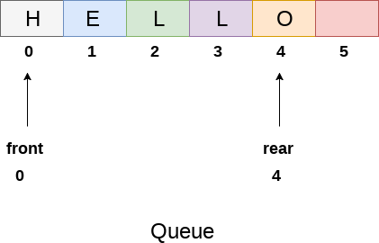
Data Structure Presentation
Array Representation of Queue:- We can easily represent queue by using linear arrays. There are two variables i.e. front and rear, that are implemented in the case of every queue. Front and rear variables point to the position from where insertions and deletions are performed in a queue. Initially, the value of front and queue is -1 which represents an empty queue. Array representation of a queue containing 5 elements along with the respective values of front and rear, is shown in the following figure.

Slide 66
Data Structure Presentation
Algorithm to insert an element Queue:- Step 1: IF REAR = MAX - 1 Write OVERFLOW Go to step [END OF IF]
Step 2: IF FRONT = -1 and REAR = -1 SET FRONT = REAR = 0 ELSE SET REAR = REAR + 1 [END OF IF]
Step 3: Set QUEUE[REAR] = NUM
Step 4: EXIT

Slide 67
Data Structure Presentation
Algorithm to delete an element Queue:- Step 1: IF FRONT = -1 or FRONT > REAR Write UNDERFLOW ELSE SET VAL = QUEUE[FRONT] SET FRONT = FRONT + 1 [END OF IF]
Step 2: EXIT

Slide 68
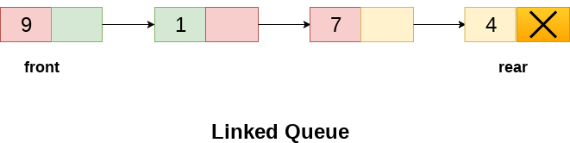
Data Structure Presentation
Linked List representation Queue:- Step 1: IF FRONT = -1 or FRONT > REAR Write UNDERFLOW ELSE SET VAL = QUEUE[FRONT] SET FRONT = FRONT + 1 [END OF IF]
Step 2: EXIT

Slide 69
Data Structure Presentation
Linked List representation Queue:- Step 1: IF FRONT = -1 or FRONT > REAR Write UNDERFLOW ELSE SET VAL = QUEUE[FRONT] SET FRONT = FRONT + 1 [END OF IF]
Step 2: EXIT

Slide 70
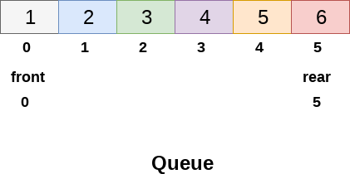
Data Structure Presentation
Circular Queue:- Deletions and insertions can only be performed at front and rear end respectively, as far as linear queue is concerned.
Consider the queue shown in the following figure

Slide 71
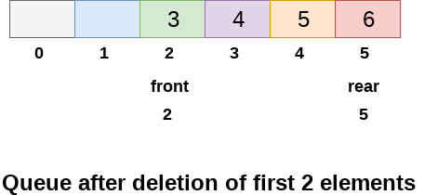
Data Structure Presentation
Circular Queue:- The Queue shown in above figure is completely filled and there can't be inserted any more element due to the condition rear == max - 1 becomes true.
However, if we delete 2 elements at the front end of the queue, we still can not insert any element since the condition rear = max -1 still holds.
This is the main problem with the linear queue, although we have space available in the array, but we can not insert any more element in the queue. This is simply the memory wastage and we need to overcome this problem.

Slide 72
Data Structure Presentation
Complexity:-
Front | O(1)
Rear | O(1)
enQueue() | O(1)
deQueue() | O(1)

Slide 73
Data Structure Presentation
Insertion In Circular Queue:-
There are three scenario of inserting an element in a queue.
If (rear + 1)%maxsize = front, the queue is full. In that case, overflow occurs and therefore, insertion can not be performed in the queue.
If rear != max - 1, then rear will be incremented to the mod(maxsize) and the new value will be inserted at the rear end of the queue.
If front != 0 and rear = max - 1, then it means that queue is not full therefore, set the value of rear to 0 and insert the new element there.

Slide 74
Data Structure Presentation
Insertion In Circular Queue:-
There are three scenario of inserting an element in a queue.
If (rear + 1)%maxsize = front, the queue is full. In that case, overflow occurs and therefore, insertion can not be performed in the queue.
If rear != max - 1, then rear will be incremented to the mod(maxsize) and the new value will be inserted at the rear end of the queue.
If front != 0 and rear = max - 1, then it means that queue is not full therefore, set the value of rear to 0 and insert the new element there.

Slide 75
Data Structure Presentation
Algorithm to Insertion In Circular Queue:-
Step 1: IF (REAR+1)%MAX = FRONT Write " OVERFLOW " Goto step 4 [End OF IF]
Step 2: IF FRONT = -1 and REAR = -1 SET FRONT = REAR = 0 ELSE IF REAR = MAX - 1 and FRONT ! = 0 SET REAR = 0 ELSE SET REAR = (REAR + 1) % MAX [END OF IF]
Step 3: SET QUEUE[REAR] = VAL
Step 4: EXIT

Slide 76
Data Structure Presentation
Algorithm to Delete an element from Circular Queue:-
To delete an element from the circular queue, we must check for the three following conditions.
If front = -1, then there are no elements in the queue and therefore this will be the case of an underflow condition.
If there is only one element in the queue, in this case, the condition rear = front holds and therefore, both are set to -1 and the queue is deleted completely.
If front = max -1 then, the value is deleted from the front end the value of front is set to 0.
Otherwise, the value of front is incremented by 1 and then delete the element at the front end.

Slide 77
Data Structure Presentation
Algorithm to Delete an element from Circular Queue:-
Step 1: IF FRONT = -1 Write " UNDERFLOW " Goto Step 4 [END of IF]
Step 2: SET VAL = QUEUE[FRONT]
Step 3: IF FRONT = REAR SET FRONT = REAR = -1 ELSE IF FRONT = MAX -1 SET FRONT = 0 ELSE SET FRONT = FRONT + 1 [END of IF] [END OF IF]
Step 4: EXIT

Slide 78
Data Structure Presentation
Tree:- A Tree is a recursive data structure containing the set of one or more data nodes where one node is designated as the root of the tree while the remaining nodes are called as the children of the root.
The nodes other than the root node are partitioned into the non empty sets where each one of them is to be called sub-tree.
Nodes of a tree either maintain a parent-child relationship between them or they are sister nodes.
In a general tree, A node can have any number of children nodes but it can have only a single parent.

Slide 79
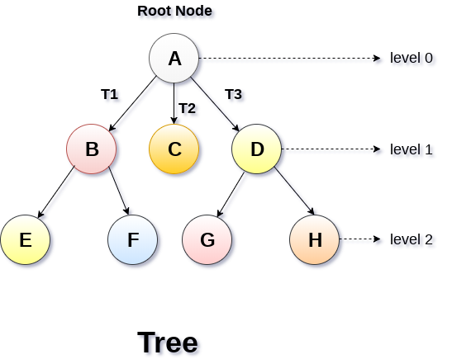
Data Structure Presentation
Tree:-

Slide 80
Data Structure Presentation
Tree Basic Terminology:-
Root Node :- The root node is the topmost node in the tree hierarchy. In other words, the root node is the one which doesn't have any parent.
Sub Tree :- If the root node is not null, the tree T1, T2 and T3 is called sub-trees of the root node.
Leaf Node :- The node of tree, which doesn't have any child node, is called leaf node. Leaf node is the bottom most node of the tree. There can be any number of leaf nodes present in a general tree. Leaf nodes can also be called external nodes.
Path :- The sequence of consecutive edges is called path. In the tree shown in the above image, path to the node E is A→ B → E.

Slide 81
Data Structure Presentation
Tree Basic Terminology:-
Ancestor node :- An ancestor of a node is any predecessor node on a path from root to that node. The root node doesn't have any ancestors. In the tree shown in the above image, the node F have the ancestors, B and A.
Degree :- Degree of a node is equal to number of children, a node have. In the tree shown in the above image, the degree of node B is 2. Degree of a leaf node is always 0 while in a complete binary tree, degree of each node is equal to 2.
Level Number :- Each node of the tree is assigned a level number in such a way that each node is present at one level higher than its parent. Root node of the tree is always present at level 0.

Slide 82
Data Structure Presentation
Static Representation of Tree:-
#define MAXNODE 500
struct treenode {
int root;
int father;
int son;
int next;
}

Slide 83
Data Structure Presentation
Dynamic Representation of Tree:-
struct treenode
{
int root;
struct treenode *father;
struct treenode *son
struct treenode *next;
}

Slide 84
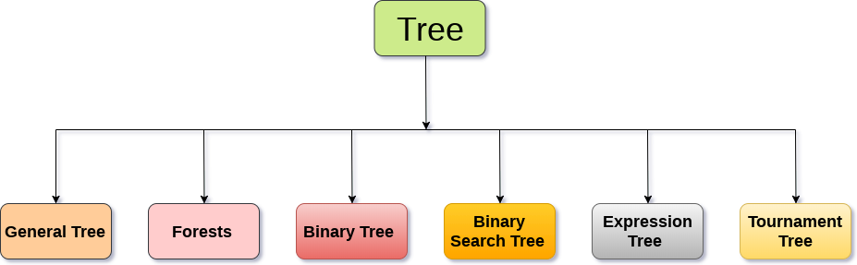
Data Structure Presentation
Types of Tree:- The Tree structure can be categorised into six different categories. They are as follows:

Slide 85
Data Structure Presentation
Types of Tree:- The Tree structure can be categorised into six different categories. They are as follows:

Slide 86
Data Structure Presentation
Types of Tree:-
General Tree:- General Tree stores the elements in a hierarchical order in which the top level element is always present at level 0 as the root element. All the nodes except the root node are present at number of levels. The nodes which are present on the same level are called siblings while the nodes which are present on the different levels exhibit the parent-child relationship among them. A node may contain any number of sub-trees. The tree in which each node contain 3 sub-tree, is called ternary tree.

Slide 87
Data Structure Presentation
Types of Tree:-
Binary Tree:- Binary Tree is a special type of generic tree in which, each node can have at most two children. Binary tree is generally partitioned into three disjoint subsets.
Root of the node
left sub-tree which is also a binary tree.
Right binary sub-tree

Slide 88
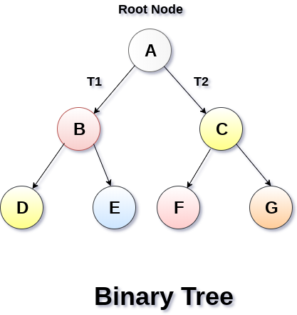
Data Structure Presentation
Types of Tree:-
Binary Tree:-

Slide 89
Data Structure Presentation
Types of Binary Tree:-
Strictly Binary Tree
Complete Binary Tree

Slide 90
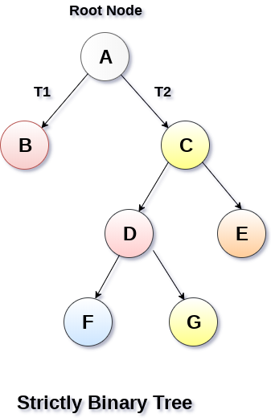
Data Structure Presentation
Types of Binary Tree:-
Strictly Binary Tree:- In Strictly Binary Tree, every non-leaf node contain non-empty left and right sub-trees. In other words, the degree of every non-leaf node will always be 2. A strictly binary tree with n leaves, will have (2n - 1) nodes.
A strictly binary tree is shown in the following figure.

Slide 91
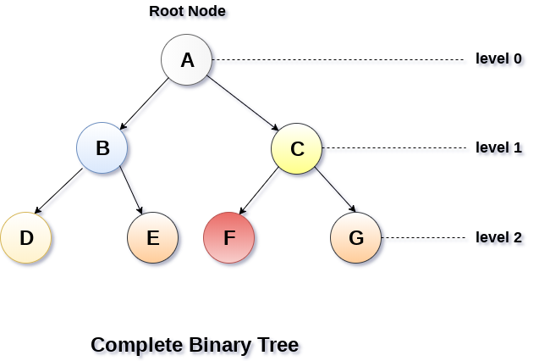
Data Structure Presentation
Types of Binary Tree:-
Complete Binary Tree:- A Binary Tree is said to be a complete binary tree if all of the leaves are located at the same level d. A complete binary tree is a binary tree that contains exactly 2^l nodes at each level between level 0 and d. The total number of nodes in a complete binary tree with depth d is 2^{d+1}-1 where leaf nodes are 2^{d} while non-leaf nodes are 2^{d}-1.

Slide 92
Data Structure Presentation
Binary Tree Traversal:-
SN | Traversal | Description
1 | Pre-order Traversal | Traverse the root first then traverse into the left sub-tree and right sub-tree respectively. This procedure will be applied to each sub-tree of the tree recursively.
2 | In-order Traversal | Traverse the left sub-tree first, and then traverse the root and the right sub-tree respectively. This procedure will be applied to each sub-tree of the tree recursively.
3 | Post-order Traversal | Traverse the left sub-tree and then traverse the right sub-tree and root respectively. This procedure will be applied to each sub-tree of the tree recursively.

Slide 93
Data Structure Presentation
Binary Tree Representation:-
1. Linked Representation
2. Tree Representation

Slide 94
Data Structure Presentation
Binary Search Tree:- Binary Search tree can be defined as a class of binary trees, in which the nodes are arranged in a specific order. This is also called ordered binary tree.
In a binary search tree, the value of all the nodes in the left sub-tree is less than the value of the root.
Similarly, value of all the nodes in the right sub-tree is greater than or equal to the value of the root.
This rule will be recursively applied to all the left and right sub-trees of the root.

Slide 95
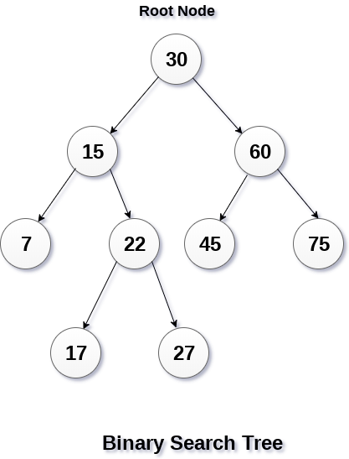
Data Structure Presentation
Binary Search Tree:-

Slide 96
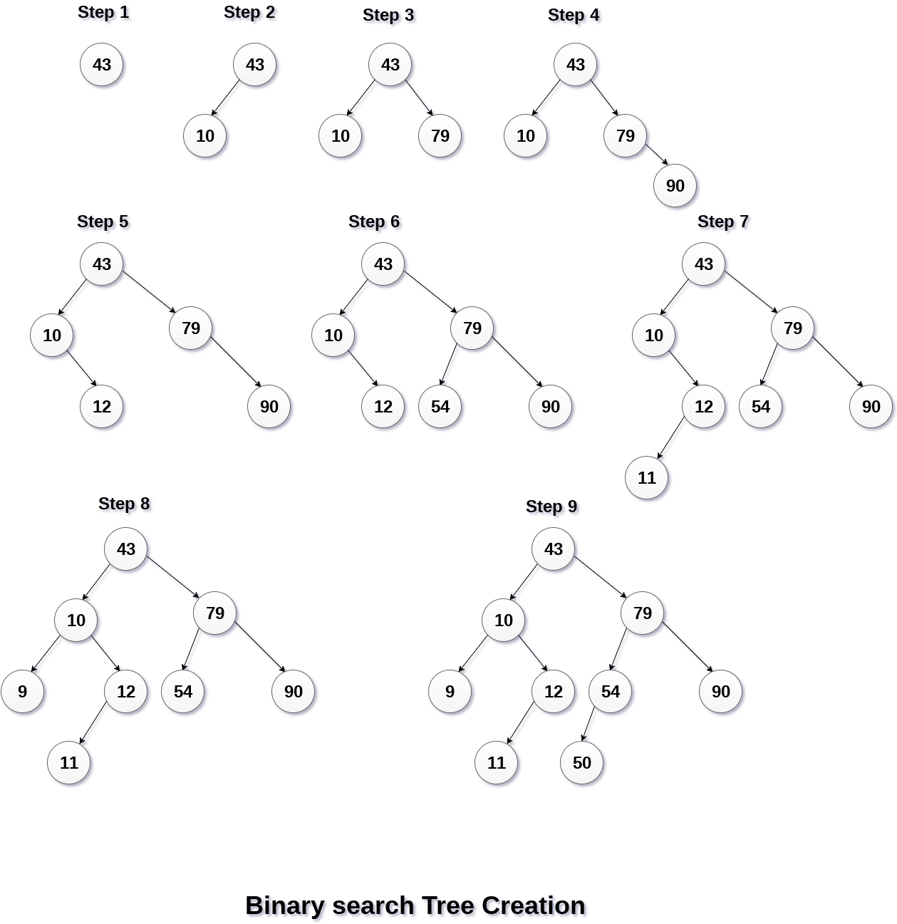
Data Structure Presentation
Binary Search Tree:-

Slide 97
Data Structure Presentation
Operations on Binary Search Tree:-
SN | Operation | Description
1 | Searching in BST | Finding the location of some specific element in a binary search tree.
2 | Insertion in BST | Adding a new element to the binary search tree at the appropriate location so that the property of BST do not violate.
3 | Deletion in BST | Deleting some specific node from a binary search tree. However, there can be various cases in deletion depending upon the number of children, the node have.

Slide 98
Data Structure Presentation
AVL Tree:- AVL Tree is invented by GM Adelson - Velsky and EM Landis in 1962. The tree is named AVL in honour of its inventors.
AVL Tree can be defined as height balanced binary search tree in which each node is associated with a balance factor which is calculated by subtracting the height of its right sub-tree from that of its left sub-tree.
Tree is said to be balanced if balance factor of each node is in between -1 to 1, otherwise, the tree will be unbalanced and need to be balanced.

Slide 99
Data Structure Presentation
AVL Tree:-
Balance Factor (k) = height (left(k)) - height (right(k))
If balance factor of any node is 1, it means that the left sub-tree is one level higher than the right sub-tree.
If balance factor of any node is 0, it means that the left sub-tree and right sub-tree contain equal height.
If balance factor of any node is -1, it means that the left sub-tree is one level lower than the right sub-tree.
An AVL tree is given in the following figure. We can see that, balance factor associated with each node is in between -1 and +1. therefore, it is an example of AVL tree.

Slide 100
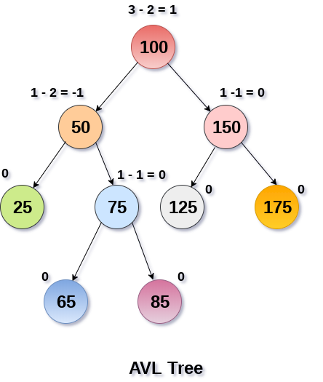
Data Structure Presentation
AVL Tree:-

Slide 101
Data Structure Presentation
Complexity of AVL Tree:-
Algorithm | Average case | Worst case
Space | o(n) | o(n)
Search | o(log n) | o(log n)
Insert | o(log n) | o(log n)
Delete | o(log n) | o(log n)

Slide 102
Data Structure Presentation
B Tree:- B Tree is a specialized m-way tree that can be widely used for disk access. A B-Tree of order m can have at most m-1 keys and m children. One of the main reason of using B tree is its capability to store large number of keys in a single node and large key values by keeping the height of the tree relatively small.
A B tree of order m contains all the properties of an M way tree. In addition, it contains the following properties.
Every node in a B-Tree contains at most m children.
Every node in a B-Tree except the root node and the leaf node contain at least m/2 children.
The root nodes must have at least 2 nodes.
All leaf nodes must be at the same level.
It is not necessary that, all the nodes contain the same number of children but, each node must have m/2 number of nodes.

Slide 103
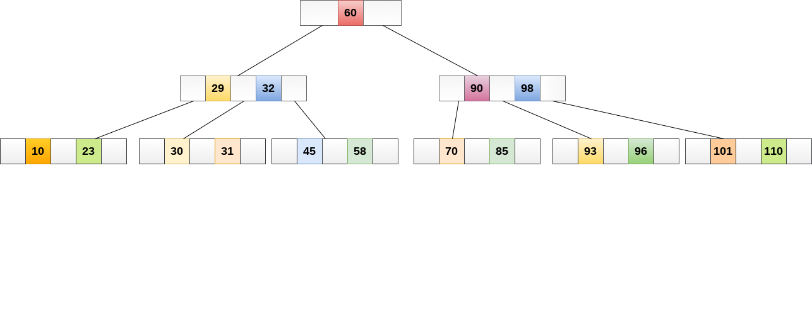
Data Structure Presentation
B Tree:- A B Tree may have the following images:

Slide 104
Data Structure Presentation
B Tree Operations:- We can perform different types of operation on B Tree. They are as follows:
Searching
Insertion
Deletion

Slide 105
Data Structure Presentation
B Tree Operations:-
Searching:- Searching in B Trees is similar to that in Binary search tree. For example, if we search for an item 49 in the following B Tree. The process will something like following :
Compare item 49 with root node 78. since 49 < 78 hence, move to its left sub-tree.
Since, 40<49<56, traverse right sub-tree of 40.
49>45, move to right. Compare 49.
match found, return.
Searching in a B tree depends upon the height of the tree. The search algorithm takes O(log n) time to search any element in a B tree.

Slide 106
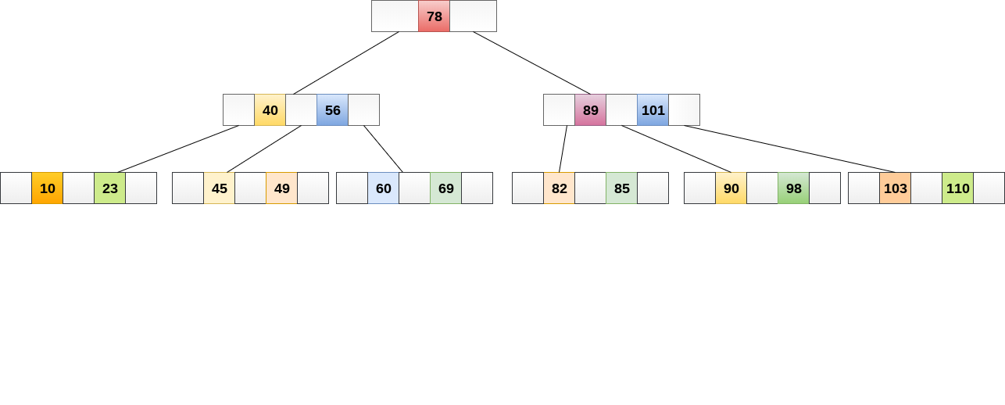
Data Structure Presentation
B Tree Operations:-
Searching:-

Slide 107
Data Structure Presentation
B Tree Operations:-
Inserting:- Insertions are done at the leaf node level. The following algorithm needs to be followed in order to insert an item into B Tree.
Traverse the B Tree in order to find the appropriate leaf node at which the node can be inserted.
If the leaf node contain less than m-1 keys then insert the element in the increasing order.
Else, if the leaf node contains m-1 keys, then follow the following steps.
Insert the new element in the increasing order of elements.
Split the node into the two nodes at the median.
Push the median element upto its parent node.
If the parent node also contain m-1 number of keys, then split it too by following the same steps.

Slide 108
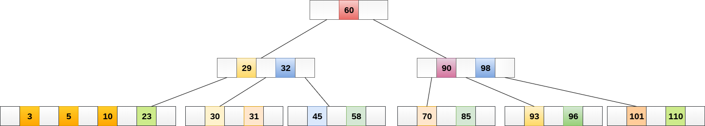
Data Structure Presentation
B Tree Operations:-
Inserting:- Insert the node 8 into the B Tree of order 5 shown in the following image.
Now 8 will be inserted to the right of 5

Slide 109
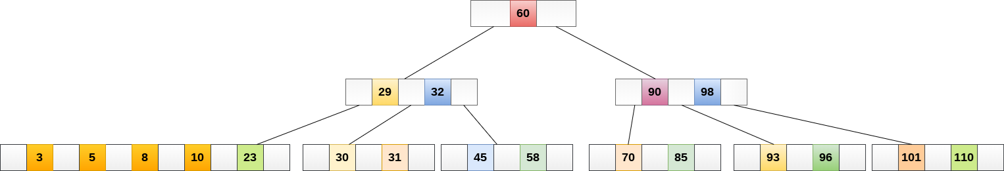
Data Structure Presentation
B Tree Operations:-
Inserting:-
Now 8 will be inserted to the right of 5

Slide 110
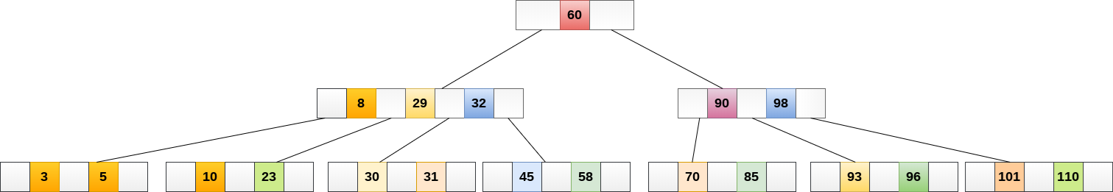
Data Structure Presentation
B Tree Operations:-
Inserting:- The node, now contain 5 keys which is greater than (5 -1 = 4 ) keys. Therefore split the node from the median i.e. 8 and push it up to its parent node shown as follows.

Slide 111
Data Structure Presentation
B Tree Operations:-
Inserting:- The node, now contain 5 keys which is greater than (5 -1 = 4 ) keys. Therefore split the node from the median i.e. 8 and push it up to its parent node shown as follows.

Slide 112
Data Structure Presentation
B Tree Operations:-
Deletion:- Deletion is also performed at the leaf nodes. The node which is to be deleted can either be a leaf node or an internal node. Following algorithm needs to be followed in order to delete a node from a B tree.
Locate the leaf node.
If there are more than m/2 keys in the leaf node then delete the desired key from the node.
If the leaf node doesn't contain m/2 keys then complete the keys by taking the element from eight or left sibling.

Slide 113
Data Structure Presentation
B Tree Application:- B tree is used to index the data and provides fast access to the actual data stored on the disks since, the access to value stored in a large database that is stored on a disk is a very time consuming process.
Searching an un-indexed and unsorted database containing n key values needs O(n) running time in worst case. However, if we use B Tree to index this database, it will be searched in O(log n) time in worst case.

Slide 114
Data Structure Presentation
B+ Tree:- B+ Tree is an extension of B Tree which allows efficient insertion, deletion and search operations.
In B Tree, Keys and records both can be stored in the internal as well as leaf nodes. Whereas, in B+ tree, records (data) can only be stored on the leaf nodes while internal nodes can only store the key values.
The leaf nodes of a B+ tree are linked together in the form of a singly linked lists to make the search queries more efficient.
B+ Tree are used to store the large amount of data which can not be stored in the main memory. Due to the fact that, size of main memory is always limited, the internal nodes (keys to access records) of the B+ tree are stored in the main memory whereas, leaf nodes are stored in the secondary memory.

Slide 115
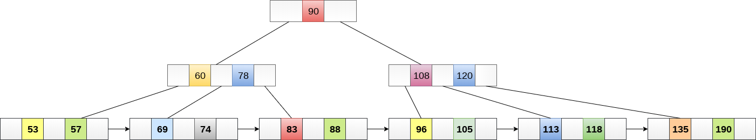
Data Structure Presentation
B+ Tree:-

Slide 116
Data Structure Presentation
Advantages of B+ Tree:-
Records can be fetched in equal number of disk accesses.
Height of the tree remains balanced and less as compare to B tree.
We can access the data stored in a B+ tree sequentially as well as directly.
Keys are used for indexing.
Faster search queries as the data is stored only on the leaf nodes.

Slide 117
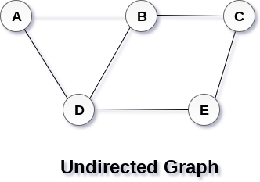
Data Structure Presentation
DS Graph:- A graph can be defined as group of vertices and edges that are used to connect these vertices. A graph can be seen as a cyclic tree, where the vertices (Nodes) maintain any complex relationship among them instead of having parent child relationship.
Definition:-A graph G can be defined as an ordered set G(V, E) where V(G) represents the set of vertices and E(G) represents the set of edges which are used to connect these vertices.
A Graph G(V, E) with 5 vertices (A, B, C, D, E) and six edges ((A,B), (B,C), (C,E), (E,D), (D,B), (D,A)) is shown in the following figure.

Slide 118
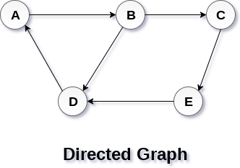
Data Structure Presentation
Directed Graph:- A graph can be directed or undirected. However, in an undirected graph, edges are not associated with the directions with them. An undirected graph is shown in the above figure since its edges are not attached with any of the directions. If an edge exists between vertex A and B then the vertices can be traversed from B to A as well as A to B.
In a directed graph, edges form an ordered pair. Edges represent a specific path from some vertex A to another vertex B. Node A is called initial node while node B is called terminal node.

Slide 119
Data Structure Presentation
Graph Terminology:-
Path:-A path can be defined as the sequence of nodes that are followed in order to reach some terminal node V from the initial node U.
Closed Path:-A path will be called as closed path if the initial node is same as terminal node. A path will be closed path if V₀=V_{N}.
Simple Path:-If all the nodes of the graph are distinct with an exception V₀=V_{N}, then such path P is called as closed simple path.
Cycle:-A cycle can be defined as the path which has no repeated edges or vertices except the first and last vertices.
Complete Graph:-A complete graph is the one in which every node is connected with all other nodes. A complete graph contain n(n-1)/2 edges where n is the number of nodes in the graph.

Slide 120
Data Structure Presentation
Graph Terminology:-
Weighted Graph:- In a weighted graph, each edge is assigned with some data such as length or weight. The weight of an edge e can be given as w(e) which must be a positive (+) value indicating the cost of traversing the edge.
Digraph:- A digraph is a directed graph in which each edge of the graph is associated with some direction and the traversing can be done only in the specified direction.
Loop:- An edge that is associated with the similar end points can be called as Loop.
Adjacent Nodes:- If two nodes u and v are connected via an edge e, then the nodes u and v are called as neighbors or adjacent nodes.
Degree of the Node:- A degree of a node is the number of edges that are connected with that node. A node with degree 0 is called as isolated node.

Slide 121
Data Structure Presentation
Graph Traversal Algorithm:- In this part of the tutorial we will discuss the techniques by using which, we can traverse all the vertices of the graph.
Traversing the graph means examining all the nodes and vertices of the graph. There are two standard methods by using which, we can traverse the graphs. Lets discuss each one of them in detail.
Breadth First Search
Depth First Search

Slide 122
Data Structure Presentation
Graph Traversal Algorithm:-
Breadth First Search:- Breadth first search is a graph traversal algorithm that starts traversing the graph from root node and explores all the neighbouring nodes. Then, it selects the nearest node and explore all the unexplored nodes. The algorithm follows the same process for each of the nearest node until it finds the goal.
The algorithm of breadth first search is given below. The algorithm starts with examining the node A and all of its neighbours. In the next step, the neighbours of the nearest node of A are explored and process continues in the further steps. The algorithm explores all neighbours of all the nodes and ensures that each node is visited exactly once and no node is visited twice.

Slide 123
Data Structure Presentation
Graph Traversal Algorithm:-
Breadth First Search Algorithm:- Step 1: SET STATUS = 1 (ready state) for each node in G
Step 2: Enqueue the starting node A and set its STATUS = 2 (waiting state)
Step 3: Repeat Steps 4 and 5 until QUEUE is empty
Step 4: Dequeue a node N. Process it and set its STATUS = 3 (processed state).
Step 5: Enqueue all the neighbours of N that are in the ready state (whose STATUS = 1) and set their STATUS = 2 (waiting state) [END OF LOOP]
Step 6: EXIT

Slide 124
Data Structure Presentation
Graph Traversal Algorithm:-
Depth First Search Algorithm:- Depth first search (DFS) algorithm starts with the initial node of the graph G, and then goes to deeper and deeper until we find the goal node or the node which has no children. The algorithm, then backtracks from the dead end towards the most recent node that is yet to be completely unexplored.
The data structure which is being used in DFS is stack. The process is similar to BFS algorithm. In DFS, the edges that leads to an unvisited node are called discovery edges while the edges that leads to an already visited node are called block edges.

Slide 125
Data Structure Presentation
Graph Traversal Algorithm:-
Depth First Search Algorithm:- Step 1: SET STATUS = 1 (ready state) for each node in G
Step 2: Push the starting node A on the stack and set its STATUS = 2 (waiting state)
Step 3: Repeat Steps 4 and 5 until STACK is empty
Step 4: Pop the top node N. Process it and set its STATUS = 3 (processed state)
Step 5: Push on the stack all the neighbours of N that are in the ready state (whose STATUS = 1) and set their STATUS = 2 (waiting state) [END OF LOOP]
Step 6: EXIT

Slide 126
Data Structure Presentation
Spanning Tree:- Spanning tree can be defined as a sub-graph of connected, undirected graph G that is a tree produced by removing the desired number of edges from a graph. In other words, Spanning tree is a non-cyclic sub-graph of a connected and undirected graph G that connects all the vertices together. A graph G can have multiple spanning trees.
Minimum Spanning Tree:- There can be weights assigned to every edge in a weighted graph. However, A minimum spanning tree is a spanning tree which has minimal total weight. In other words, minimum spanning tree is the one which contains the least weight among all other spanning tree of some particular graph.
Shortest path algorithms:- In this section of the tutorial, we will discuss the algorithms to calculate the shortest path between two nodes in a graph.
There are two algorithms which are being used for this purpose.
Prim's Algorithm
Kruskal's Algorithm

Slide 127
Data Structure Presentation
Searching:- Searching is the process of finding some particular element in the list. If the element is present in the list, then the process is called successful and the process returns the location of that element, otherwise the search is called unsuccessful.
There are two popular search methods that are widely used in order to search some item into the list. However, choice of the algorithm depends upon the arrangement of the list.
Linear Search
Binary Search

Slide 128
Data Structure Presentation
Searching:-
Linear Search:- Linear search is the simplest search algorithm and often called sequential search. In this type of searching, we simply traverse the list completely and match each element of the list with the item whose location is to be found. If the match found then location of the item is returned otherwise the algorithm return NULL.

Slide 129
Data Structure Presentation
Searching:-
Algorithm for Linear Search:- LINEAR_SEARCH(A, N, VAL)
Step 1: [INITIALIZE] SET POS = -1
Step 2: [INITIALIZE] SET I = 1
Step 3: Repeat Step 4 while I<=N
Step 4: IF A[I] = VAL SET POS = I PRINT POS Go to Step 6 [END OF IF] SET I = I + 1 [END OF LOOP]
Step 5: IF POS = -1 PRINT " VALUE IS NOT PRESENTIN THE ARRAY " [END OF IF]
Step 6: EXIT

Slide 130
Data Structure Presentation
Searching:-
Binary Search:- Binary search is the search technique which works efficiently on the sorted lists. Hence, in order to search an element into some list by using binary search technique, we must ensure that the list is sorted.
Binary search follows divide and conquer approach in which, the list is divided into two halves and the item is compared with the middle element of the list. If the match is found then, the location of middle element is returned otherwise, we search into either of the halves depending upon the result produced through the match.

Slide 131
Data Structure Presentation
Searching:-
Binary Search Algorithm:- Step 1: [INITIALIZE] SET BEG = lower_bound END = upper_bound, POS = - 1
Step 2: Repeat Steps 3 and 4 while BEG <=END
Step 3: SET MID = (BEG + END)/2
Step 4: IF A[MID] = VAL SET POS = MID PRINT POS Go to Step 6 ELSE IF A[MID] > VAL SET END = MID - 1 ELSE SET BEG = MID + 1 [END OF IF] [END OF LOOP]
Step 5: IF POS = -1 PRINT "VALUE IS NOT PRESENT IN THE ARRAY" [END OF IF]
Step 6: EXIT

Slide 132
Data Structure Presentation
Complexity of Binary Search:-
SN | Performance | Complexity
1 | Worst case | O(log n)
2 | Best case | O(1)
3 | Average Case | O(log n)
4 | Worst case space complexity | O(1)

Slide 133
Data Structure Presentation
Bubble Sort:- In Bubble sort, Each element of the array is compared with its adjacent element. The algorithm processes the list in passes. A list with n elements requires n-1 passes for sorting. Consider an array A of n elements whose elements are to be sorted by using Bubble sort. The algorithm processes like following.
In Pass 1, A[0] is compared with A[1], A[1] is compared with A[2], A[2] is compared with A[3] and so on. At the end of pass 1, the largest element of the list is placed at the highest index of the list.
In Pass 2, A[0] is compared with A[1], A[1] is compared with A[2] and so on. At the end of Pass 2 the second largest element of the list is placed at the second highest index of the list.
In pass n-1, A[0] is compared with A[1], A[1] is compared with A[2] and so on. At the end of this pass. The smallest element of the list is placed at the first index of the list.

Slide 134
Data Structure Presentation
Algorithm of Bubble Sort:-
Step 1: Repeat Step 2 For i = 0 to N-1
Step 2: Repeat For J = i + 1 to N - I
Step 3: IF A[J] > A[i] SWAP A[J] and A[i] [END OF INNER LOOP] [END OF OUTER LOOP
Step 4: EXIT

Slide 135
Data Structure Presentation
Complexity of Bubble Sort:-
Scenario | Complexity
Space | O(1)
Worst case running time | O(n²)
Average case running time | O(n)
Best case running time | O(n²)

Slide 136
Data Structure Presentation
Bucket Sort:- Bucket sort is also known as bin sort. It works by distributing the element into the array also called buckets. Buckets are sorted individually by using different sorting algorithm.

Slide 137
Data Structure Presentation
Algorithm of Bucket Sort:-
Step 1 START
Step 2 Set up an array of initially empty "buckets".
Step 3 Scatter: Go over the original array, putting each object in its bucket.
Step 4 Sort each non-empty bucket.
Step 5 Gather: Visit the buckets in order and put all elements back into the original array.
Step 6 STOP

Slide 138
Data Structure Presentation
Complexity of Bucket Sort:-
Scenario | Complexity
Space | O(1)
Worst Case | O(n²)
Best Case | Ω(n+k)
Average Case | θ(n+k)

Slide 139
Data Structure Presentation
Heap Sort:- Heap sort processes the elements by creating the min heap or max heap using the elements of the given array. Min heap or max heap represents the ordering of the array in which root element represents the minimum or maximum element of the array. At each step, the root element of the heap gets deleted and stored into the sorted array and the heap will again be heapified.
The heap sort basically recursively performs two main operations.
Build a heap H, using the elements of ARR.
Repeatedly delete the root element of the heap formed in phase 1.

Slide 140
Data Structure Presentation
Algorithm of Heap Sort:-
HEAP_SORT(ARR, N)
Step 1: [Build Heap H] Repeat for i=0 to N-1 CALL INSERT_HEAP(ARR, N, ARR[i]) [END OF LOOP]
Step 2: Repeatedly Delete the root element Repeat while N > 0 CALL Delete_Heap(ARR,N,VAL) SET N = N+1 [END OF LOOP]
Step 3: END

Slide 141
Data Structure Presentation
Complexity of Heap Sort:-
Complexity | Best Case | Average Case | Worst case
Time Complexity | Ω(n log (n)) | θ(n log (n)) | O(n log (n))
Space Complexity |  |  | O(1)

Slide 142
Data Structure Presentation
Merge Sort:- Merge sort is the algorithm which follows divide and conquer approach. Consider an array A of n number of elements. The algorithm processes the elements in 3 steps.
If A Contains 0 or 1 elements then it is already sorted, otherwise, Divide A into two sub-array of equal number of elements.
Conquer means sort the two sub-arrays recursively using the merge sort.
Combine the sub-arrays to form a single final sorted array maintaining the ordering of the array.
The main idea behind merge sort is that, the short list takes less time to be sorted.

Slide 143
Data Structure Presentation
Algorithm of Merge Sort:-
Step 1: [INITIALIZE] SET I = BEG, J = MID + 1, INDEX = 0
Step 2: Repeat while (I <= MID) AND (J<=END) IF ARR[I] < ARR[J] SET TEMP[INDEX] = ARR[I] SET I = I + 1 ELSE SET TEMP[INDEX] = ARR[J] SET J = J + 1 [END OF IF] SET INDEX = INDEX + 1 [END OF LOOP] Step 3: [Copy the remaining elements of right sub-array, if any] IF I > MID Repeat while J <= END SET TEMP[INDEX] = ARR[J]

Slide 144
Data Structure Presentation
Algorithm of Merge Sort:-
SET INDEX = INDEX + 1, SET J = J + 1 [END OF LOOP] [Copy the remaining elements of left sub-array, if any] ELSE Repeat while I <= MID SET TEMP[INDEX] = ARR[I] SET INDEX = INDEX + 1, SET I = I + 1 [END OF LOOP] [END OF IF]
Step 4: [Copy the contents of TEMP back to ARR] SET K = 0
Step 5: Repeat while K < INDEX SET ARR[K] = TEMP[K] SET K = K + 1 [END OF LOOP]
Step 6: Exit

Slide 145
Data Structure Presentation
Algorithm of Merge Sort:-
MERGE_SORT(ARR, BEG, END)
Step 1: IF BEG < END SET MID = (BEG + END)/2 CALL MERGE_SORT (ARR, BEG, MID) CALL MERGE_SORT (ARR, MID + 1, END) MERGE (ARR, BEG, MID, END) [END OF IF]
Step 2: END

Slide 146
Data Structure Presentation
Complexity of Merge Sort:-
Complexity | Best Case | Average Case | Worst case
Time Complexity | O(n log n) | O(n log n) | O(n log n)
Space Complexity |  |  | O(n)

Slide 147
Data Structure Presentation
Selection Sort:- Heap sort processes the elements by creating the min heap or max heap using the elements of the given array. Min heap or max heap represents the ordering of the array in which root element represents the minimum or maximum element of the array. At each step, the root element of the heap gets deleted and stored into the sorted array and the heap will again be heapified.
The heap sort basically recursively performs two main operations.
Build a heap H, using the elements of ARR.
Repeatedly delete the root element of the heap formed in phase 1.

Slide 148
Data Structure Presentation
Algorithm of Selection Sort:-
SELECTION SORT(ARR, N)
Step 1: Repeat Steps 2 and 3 for K = 1 to N-1
Step 2: CALL SMALLEST(ARR, K, N, POS)
Step 3: SWAP A[K] with ARR[POS] [END OF LOOP]
Step 4: EXIT

Slide 149
Data Structure Presentation
Algorithm of Selection Sort:-
SMALLEST (ARR, K, N, POS)
Step 1: [INITIALIZE] SET SMALL = ARR[K]
Step 2: [INITIALIZE] SET POS = K
Step 3: Repeat for J = K+1 to N -1 IF SMALL > ARR[J] SET SMALL = ARR[J] SET POS = J [END OF IF] [END OF LOOP]
Step 4: RETURN POS

Slide 150
Data Structure Presentation
Complexity of Selection Sort:-
Complexity | Best Case | Average Case | Worst case
Time | Ω(n) | θ(n²) | o(n²)
Space |  |  | o(1)

Slide 151
Data Structure Presentation
Insertion Sort:- Insertion sort is the simple sorting algorithm which is commonly used in the daily lives while ordering a deck of cards. In this algorithm, we insert each element onto its proper place in the sorted array. This is less efficient than the other sort algorithms like quick sort, merge sort, etc.
Technique:- Consider an array A whose elements are to be sorted. Initially, A[0] is the only element on the sorted set. In pass 1, A[1] is placed at its proper index in the array.
In pass 2, A[2] is placed at its proper index in the array. Likewise, in pass n-1, A[n-1] is placed at its proper index into the array.
To insert an element A[k] to its proper index, we must compare it with all other elements i.e. A[k-1], A[k-2], and so on until we find an element A[j] such that, A[j]<=A[k].
All the elements from A[k-1] to A[j] need to be shifted and A[k] will be moved to A[j+1].

Slide 152
Data Structure Presentation
Algorithm of Insertion Sort:-
Step 1: Repeat Steps 2 to 5 for K = 1 to N-1
Step 2: SET TEMP = ARR[K]
Step 3: SET J = K ? 1
Step 4: Repeat while TEMP <=ARR[J] SET ARR[J + 1] = ARR[J] SET J = J ? 1 [END OF INNER LOOP]
Step 5: SET ARR[J + 1] = TEMP [END OF LOOP]
Step 6: EXIT

Slide 153
Data Structure Presentation
Complexity of Insertion Sort:-
Complexity | Best Case | Average Case | Worst case
Time | Ω(n) | θ(n²) | o(n²)
Space |  |  | o(1)

Slide 154
Data Structure Presentation
Quick Sort:- Quick sort is the widely used sorting algorithm that makes n log n comparisons in average case for sorting of an array of n elements. This algorithm follows divide and conquer approach. The algorithm processes the array in the following way.
Set the first index of the array to left and loc variable. Set the last index of the array to right variable. i.e. left = 0, loc = 0, en d = n ? 1, where n is the length of the array.
Start from the right of the array and scan the complete array from right to beginning comparing each element of the array with the element pointed by loc.
Ensure that, a[loc] is less than a[right].
If this is the case, then continue with the comparison until right becomes equal to the loc.
If a[loc] > a[right], then swap the two values. And go to step 3.
Set, loc = right

Slide 155
Data Structure Presentation
Quick Sort:- start from element pointed by left and compare each element in its way with the element pointed by the variable loc. Ensure that a[loc] > a[left]
if this is the case, then continue with the comparison until loc becomes equal to left.
[loc] < a[right], then swap the two values and go to step 2.
Set, loc = left.

Slide 156
Data Structure Presentation
Algorithm of Quick Sort:-
PARTITION (ARR, BEG, END, LOC)
Step 1: [INITIALIZE] SET LEFT = BEG, RIGHT = END, LOC = BEG, FLAG =
Step 2: Repeat Steps 3 to 6 while FLAG =
Step 3: Repeat while ARR[LOC] <=ARR[RIGHT] AND LOC != RIGHT SET RIGHT = RIGHT - 1 [END OF LOOP]
Step 4: IF LOC = RIGHT SET FLAG = 1 ELSE IF ARR[LOC] > ARR[RIGHT] SWAP ARR[LOC] with ARR[RIGHT] SET LOC = RIGHT [END OF IF]
Step 5: IF FLAG = 0 Repeat while ARR[LOC] >= ARR[LEFT] AND LOC != LEFT SET LEFT = LEFT + 1 [END OF LOOP]

Slide 157
Data Structure Presentation
Algorithm of Quick Sort:-
Step 6:IF LOC = LEFT SET FLAG = 1 ELSE IF ARR[LOC] < ARR[LEFT] SWAP ARR[LOC] with ARR[LEFT] SET LOC = LEFT [END OF IF] [END OF IF]
Step 7: [END OF LOOP]
Step 8: END
QUICK_SORT (ARR, BEG, END)
Step 1: IF (BEG < END) CALL PARTITION (ARR, BEG, END, LOC) CALL QUICKSORT(ARR, BEG, LOC - 1) CALL QUICKSORT(ARR, LOC + 1, END) [END OF IF]
Step 2: END

Slide 158
Data Structure Presentation
Complexity of Quick Sort:-
Complexity | Best Case | Average Case | Worst case
Time | O(n) for 3 way partition or O(n log n) simple partition | O(n log n) | O(n²)
Space |  |  | O(log n)

Slide 159
Thank You

